Slide 1
The Nightmare
Samiul Karim
Babnit Kaur
Nirali Patel
Simratvir Singh
Notes:
Sam

Slide 2
Game Summary
This game is based on the horrors faced by Rutgers students during exam period. The character’s ultimate goal in the game is to reach his/her exam destination. The player will tackle multiple obstacles that range from solving math problems, riddles, and surviving the bus ride all while extracting clues about exam destination. If the player fails to answer a question correctly, he will die and the game will restart..
Notes:
Babnit

Slide 3
The Story
You are very desperate to pass your OOP Exam tomorrow and are pulling an all nighter studying. While studying through the wee hours of the night, you don’t realize when you knocked out. To your horror, you wake up underground! It is now up to you to get back to the surface and survive all the obstacles to take the exam before, OOPS! you’re dead. Let’s see if you can save yourself from the greatest horrors of being a Rutgers Student. Game ON!
Notes:
Babnit

Slide 4
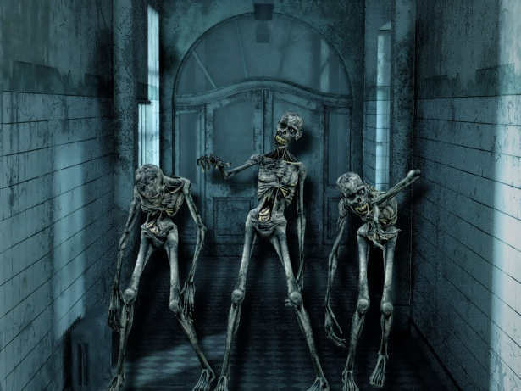
Game themes
The game is primarily a horror game with some comedic twists to it.
The student is trying to make it to their exam on time, so there is a theme of urgency
Notes:
Nirali

Slide 5
GUI
They can only type in answers for the math problems
The riddles and dialogue will be done by selecting an answer
Character will move through rooms by a random number generator
Notes:
Sam

Slide 6
What’s the objective?
Get above ground and get to the exam on time!!
What happens if you don’t?
You fail the exam
You don’t get a job
Your parents will disown you
Notes:
Sam

Slide 7
FIRST...
You will need to somehow get above onto the surface level
ITEMS NEEDED:
Key
Shovel
Torch
Box of graham crackers
Some rooms have items, some room have monsters
Notes:
Sam

Slide 8
NEXT...
You’re now above ground
You know where and when your exam is, now you have to take the bus there
Busses will have challenges like
Wet seats
Vicious service dogs
Being behind the white line
Getting off the bus
Notes:
Sam

Slide 9
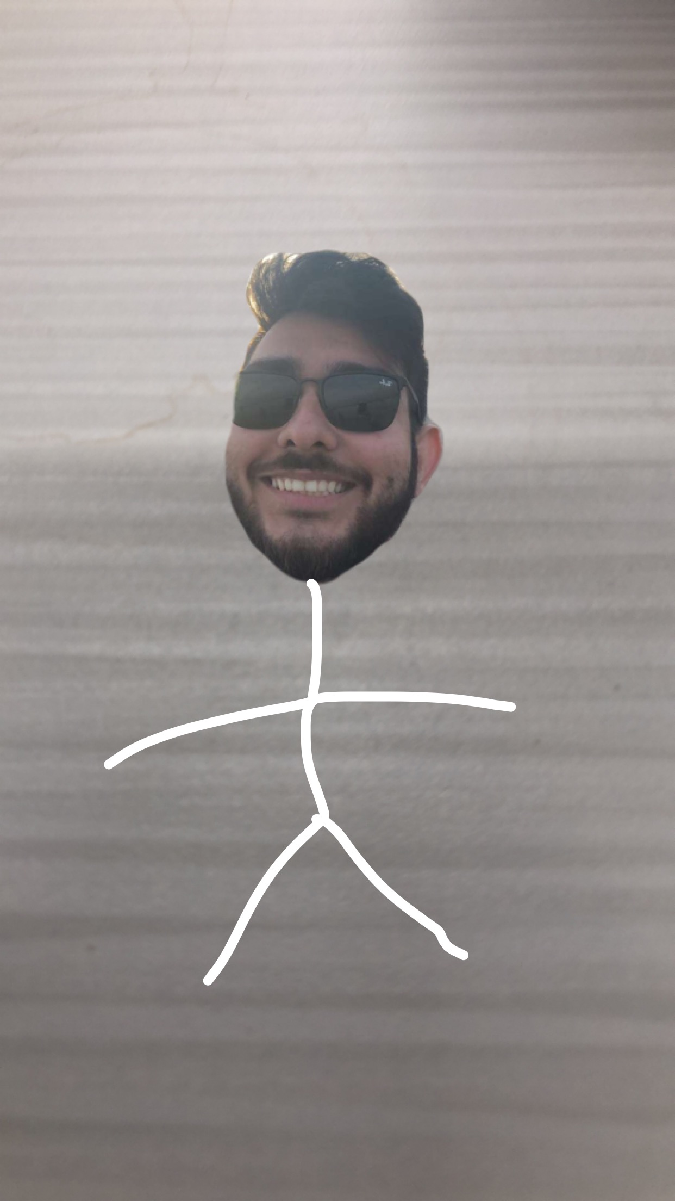
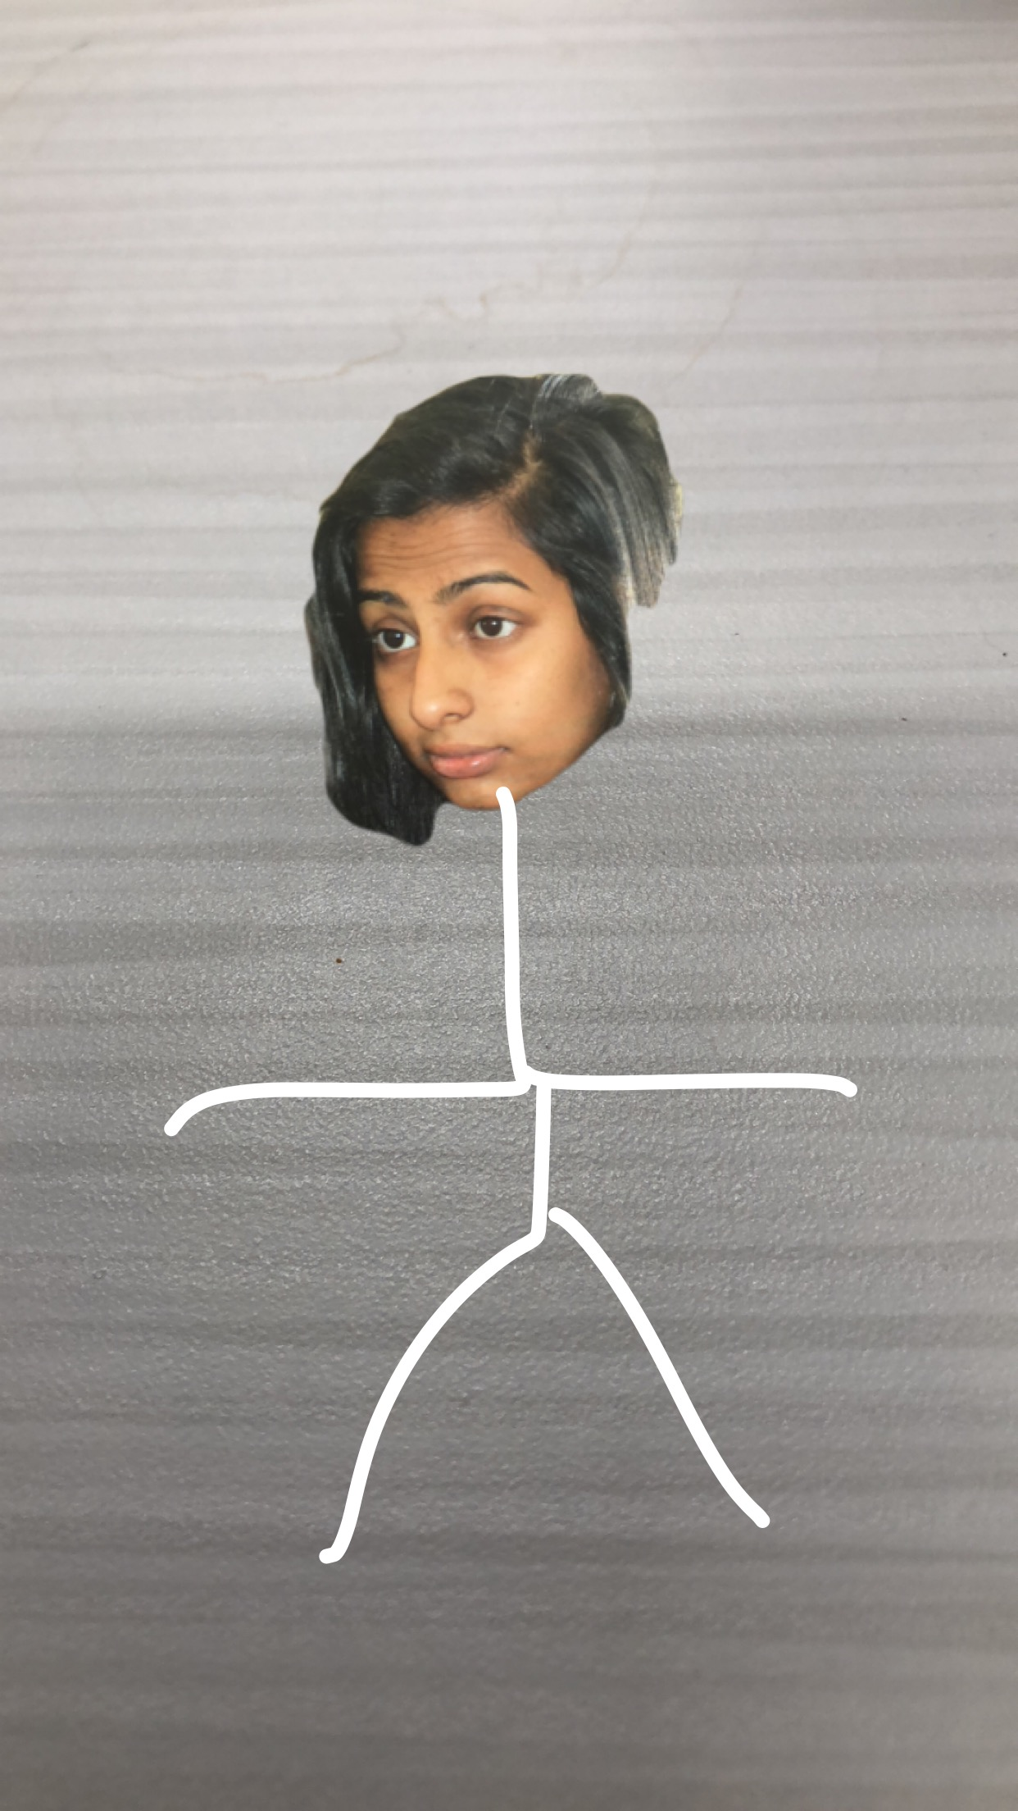
Player Description
A gender will be picked. Both the male and female will look like a typical Rutgers student. Their qualities will include:
Always late to class/ Poor attendance
The perfect image of procrastination at its best
Pulls an all-nighter
Notes:
Simi

Slide 10
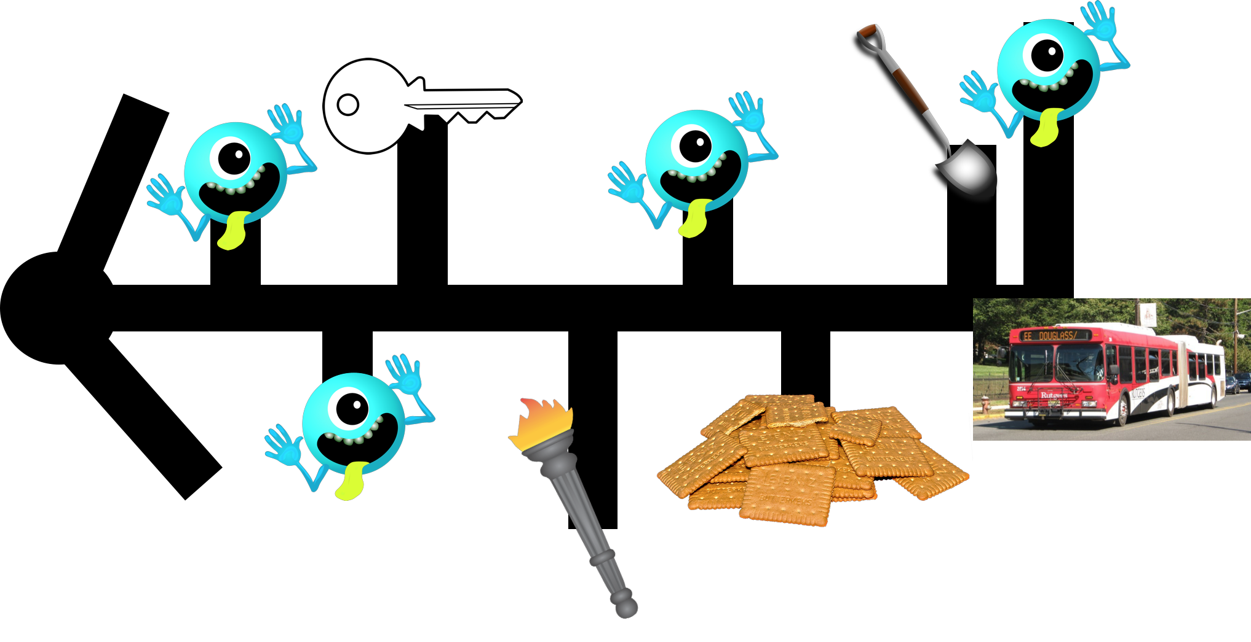
Map
Notes:
Nirali

Slide 11




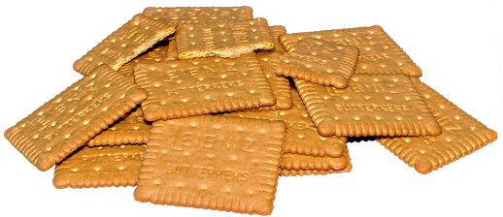
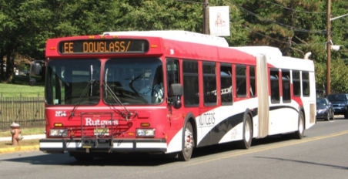
Legend
Key
Shovel
Monsters with Questions
Graham Crackers
Torch
Treasures to pick up on the way
The ride to your success
Notes:
Nirali

Slide 12
Commands
Commands in this game will be primarily text selection and typing into text box
The user will not have control over what room they enter, that is decided by the game. They will however have control over their answers
Directions for the steps through the game will be provided to the player through text boxes

Slide 13
OOP Implementation
Encapsulation:
We will store all user inputs, gained through text boxes, into private instance variables for data security.
Inheritance
We will have sub-classes that will inherit from a parent class for different types of rooms and obstacles.
Abstraction
This will be used as a dummy class to derive methods from.
Polymorphism
We will use object parent classes to create new same type objects for riddles, dialogues, and clues.

Slide 14


